Slide 1
Restaurant Recommender System- IBM Capstone Project
By Prapti Luthra

Slide 2
Purpose of the project:
What type of foods is available in the restaurant and is their variety?
Which place has the best rating near me?
How many "similar" restaurants are available near me of my previous tastes and liking?
What speciality do these restaurants have as each place tends to have some?

Slide 3
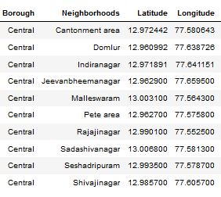
Factors considered for the study
Its geographical coordinates (latitude and longitude) to find out where exactly it is located.
Population of the neighbourhood where the restaurant is located.
Average income of neighbourhood to know how much is the restaurant worth.
Compiled Data Frame:

Slide 4
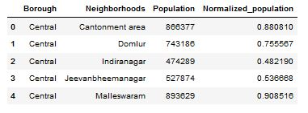
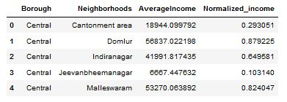
Data Representation:
Population Data Frame
Income Data Frame

Slide 5
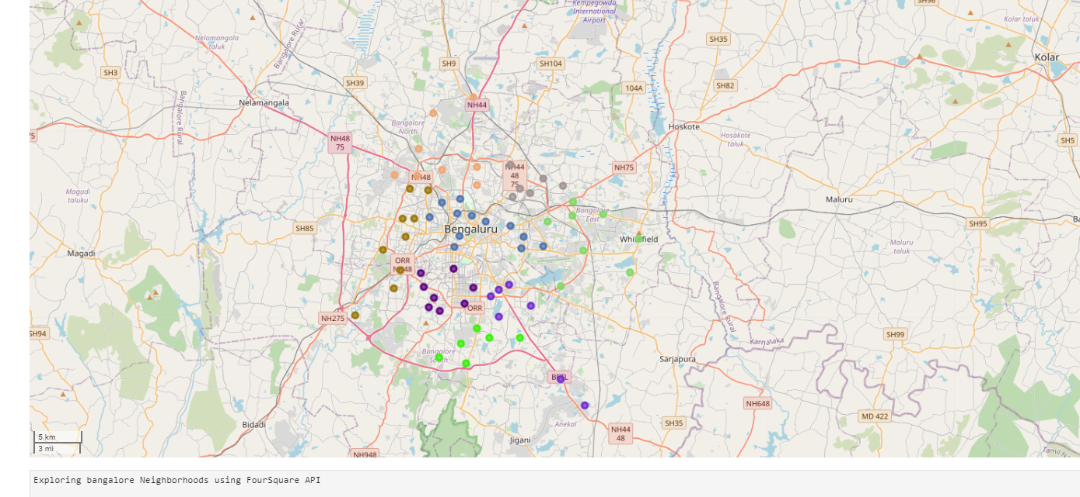
Map used to explore Bangalore Neighbours using Four Square API

Slide 6
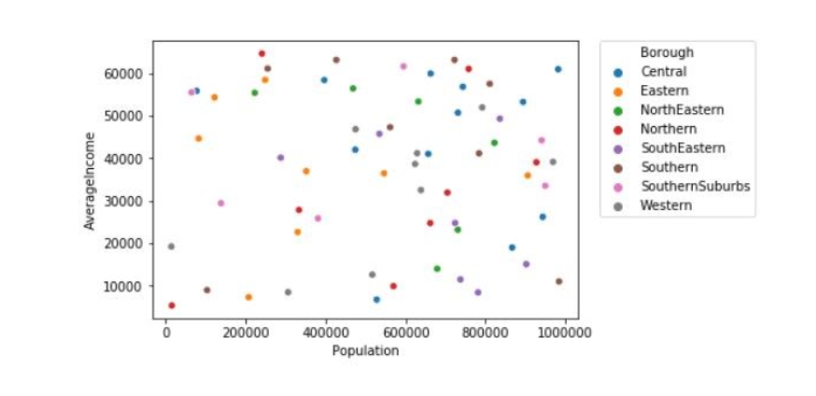
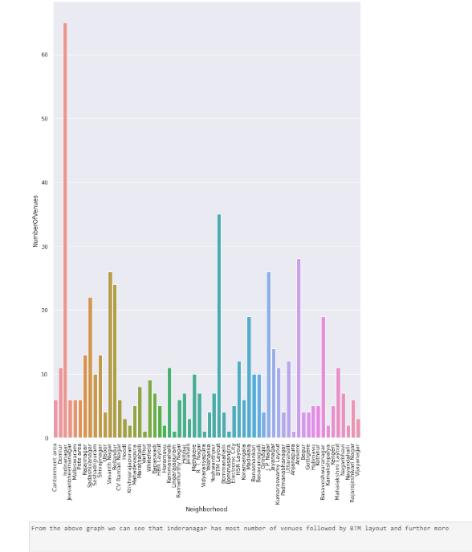
Exploratory analysis:
Inferential analysis:

Slide 7
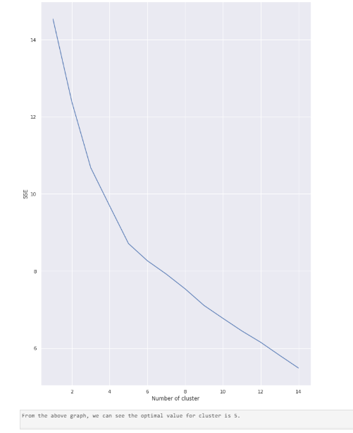
Elbow graph:
Use to find the the optimal value of “k” or the number of clusters
In this case k= 5

Slide 8
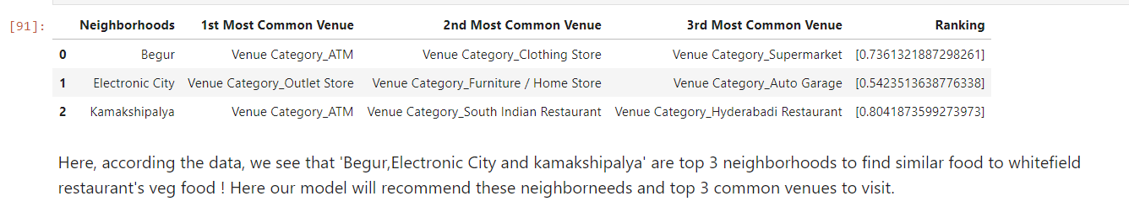
Result:

Slide 9
Thank you

